Slide 1
COEN6312
Model Driven Software Engineering
Winter 2016
Inventory Management System
Team Delta
Presented By :
Desai Parth Mukeshbhai 27397364
Jarin Manuvel Mathew 27168470
Manjot Singh Gill 27299699
Vivek Khatri 27292848
Dollar Kumar Bansal 27599188

Slide 2
Agenda
Introduction
Functional Requirements
Inventory Management Use Case Diagram
Use case
UML Class Diagram for Inventory Management System
OCL Constraints
State Diagram
Action Specification
Code Demo
Tools Used
Challenges & Lessons Learnt
Conclusion
Future Work

Slide 3
Introduction
The essential function of inventory management software is to keep an account of stock in the warehouse so that the stock is always up to date and available when needed.
Using the inventory management system we can track orders, sales ,deliveries , features of complaint tracking and report generations, which can be managed by the system.
It helps in managing the time efficiency of orders , reduce the cost of maintaining logistics and also handles the payment requests which includes tax calculations as per the government regulations.

Slide 4
Functional Requirements
User Registration and authorization
User should be able manage the Company’s stock of various materials.
User should be able to create, modify, update and delete the sales order.
User should be able to track the delivery of the product to the client.
User should be able to request for stock.
User should be able to generate various reports about the company.

Slide 5
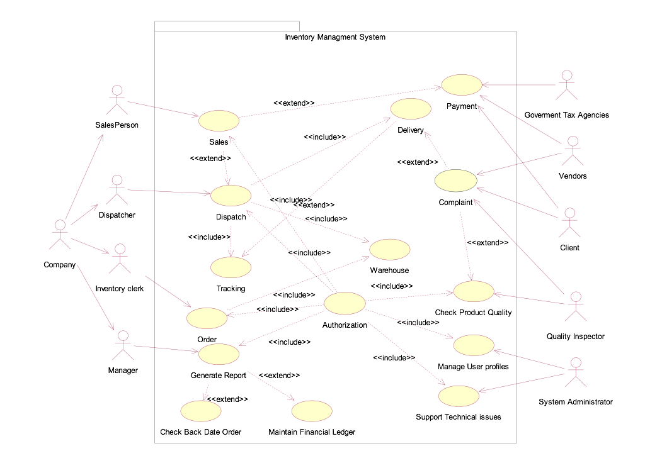
Inventory Management Use Case Diagram

Slide 6
Use case
Use Case Title | Order
Brief Description | Order records the process of ordering the raw materials from different vendors in order to update the stocks in the warehouse.
Primary Actors | Inventory Clerk
Stakeholders | Manager, Vendors, Company, salesperson, Inventory Clerk
Pre Conditions | Stock of items is low
Triggering events | Stock of a particular item(s) is low in the inventory
Main Flow | Inventory clerk checks the inventory list. If any item is missing or low in inventory then Inventory Clerk places the order with vendor. Vendor quotes the price of the items. Vendor asks for the payment. Inventory Clerk makes the payment for the items. All the items paid for are shipped by the vendor. Inventory is updated.
Alternate Flow/ Extensions | *At any time system fails, Inventory Clerk restarts system and requests recovery of prior state. System Reconstructs prior state. 2. a. System detects the problem. 2. b. Inventory Clerk starts new order. Inventory Clerk continues with the Order process. 5. Refer to payment use case.
Post conditions | Order is saved. Taxes are calculated correctly and accounting and inventory are updated. Order Receipt is generated and payment authorization approvals are recorded.

Slide 7
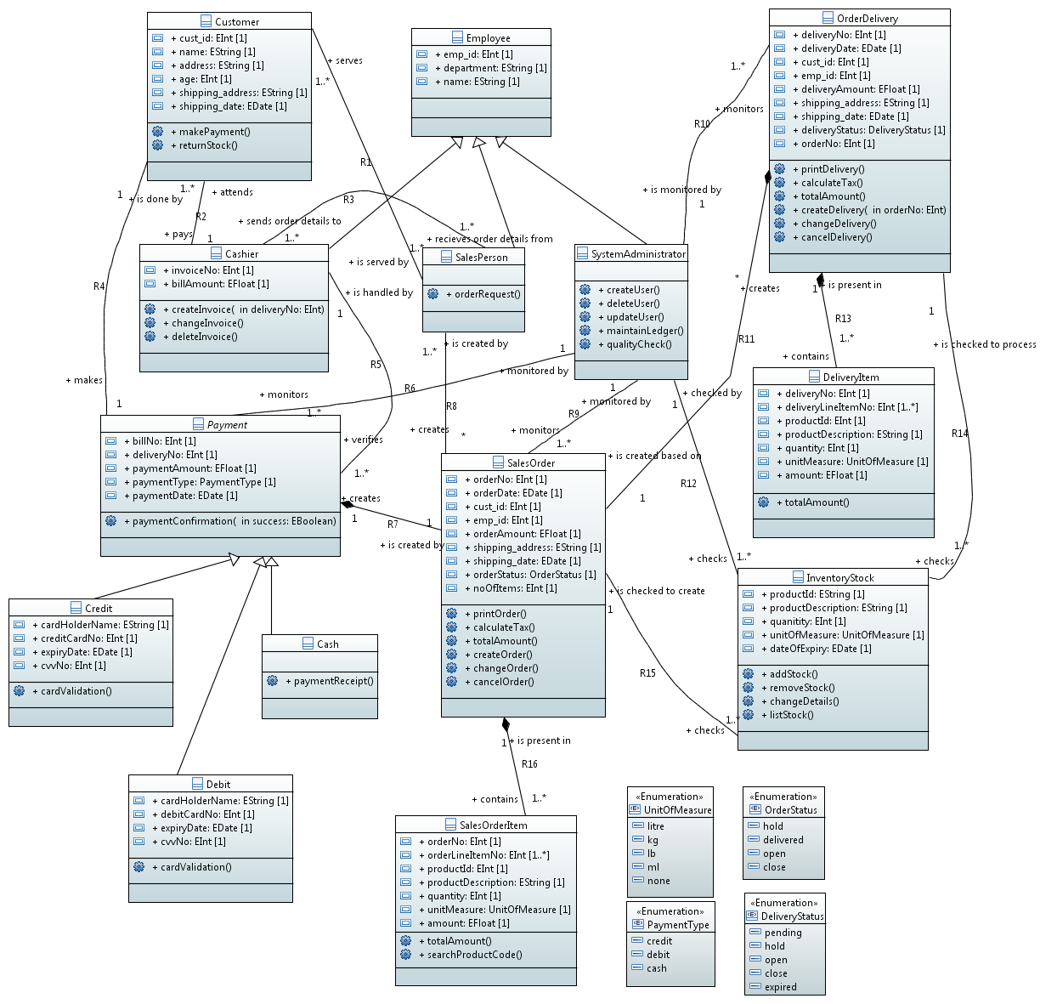
UML Class Diagram for Inventory Management System

Slide 8
OCL Constraints
An employee should have unique employee id.
Context Employee
inv: self.allInstances->forAll(e1,e2->Employee | e1<>e2 implies e1.emp_id <>e2.emp_id)
Shipping address should not be empty for OrderDelivery, SalesOrder and Customer
Context OrderDelivery
inv: self.shipping_address -> notEmpty()
Context SalesOrder
inv: self.shipping_address -> notEmpty()
Context Customer
inv: self.shipping_address -> notEmpty()

Slide 9
OCL Constraints
3) The shipping date in SalesOrder and Order delivery should not be less than the current date
Context SalesOrder
inv: self.shipping_date ->isAfter(today)
Context OrderDelivery
inv: self.shipping_date ->isAfter(today)
4)A delivery cannot be cancelled or changed after the delivery status = “close”
Context OrderDelivery::changeDelivery()
pre: self.deliveryStatus <> ‘close’
context OrderDelivery::cancelDelivery()
pre: self.deliveryStatus <> ‘close’

Slide 10
State Diagram

Slide 11
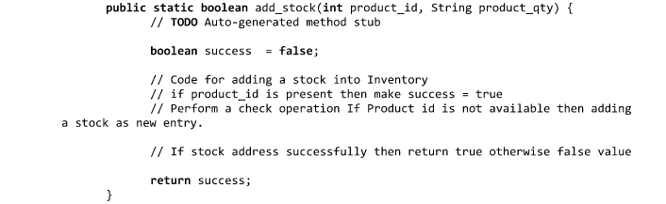
Action Specification
Action Specification language was written as a pseudo code in Java.
It helped in structuring the code in development stages

Slide 12
Code Demonstration

Slide 13
Tools Used
IBM Rational Rose for Use Case Diagram
Papyrus for Class diagram, Constraints, State Diagram and Code Generation
GitHub for repository
Google drive for file sharing
Eclipse for executable code
WhatsApp for communication

Slide 14
Challenges & Lessons Learnt (Few Amongst Many Others)
A paradigm shift from jumping straight into development to model driven development approach.
We developed an interest on working towards a Unified approach for development of systems which is less platform dependent.
We learned the implementation of OCL, which proved very useful for implementing the constraints.
Action specification language was very useful for code development.
For code generation, there were many compatibility issues in versions of Eclipse.

Slide 15
Conclusion
We learned that a better and more specified way of development is by first creating class diagrams and using the code generated by them as a framework.
OCL as well as other UML driven methodologies are a better way to proceed with software development.

Slide 16
Future Work
We can still add Graphical User interface to the system.
Database connectivity is still to be added, we are currently using key-value pairs for storing data.

